Slide 1

Low Salt Diets and Hyponatremia
Most Assisted Living Facilities for the Elderly Employ Low-Salt Diets
Long-term Low-Salt Diets Can Lead to Asymptomatic Hyponatremia
Major Dietician Associations & HHS Support SI Stance Against Low-Salt Diets
SI Program to Promote Regular Appetizing Tasty Meals

Slide 2
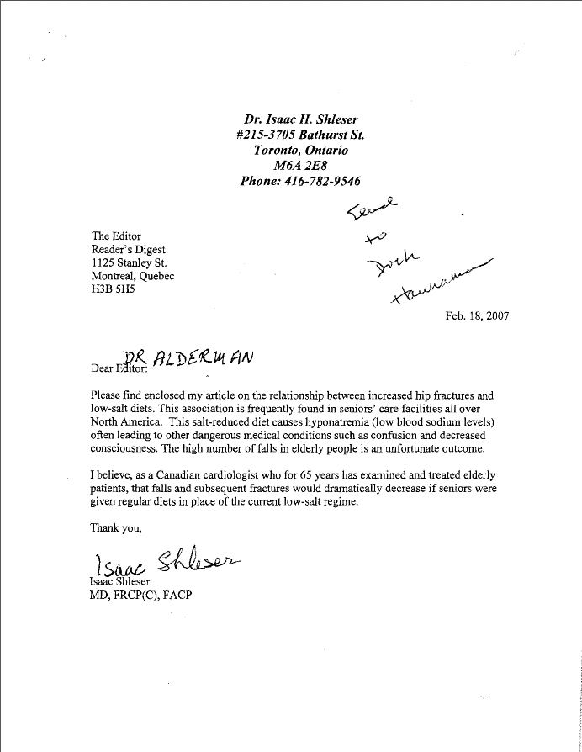
The Shleser Letter - 2007
“I believe, as a Canadian cardiologist who for 65 years has examined and treated elderly patients, that falls and subsequent fractures would dramatically decrease if seniors were given regular diets in place of the current low-salt regime.”
“After four or five months of living in the retirement residence (on a low salt diet), I gradually found that my appetite was diminished and I unknowingly become a case of chronic dehydration and hyponatriurnia (salt deficiency).”
“On January 23, 2003 I fell and broke my hip. After it was repaired the surgeon told me that I must use a walker…. It was six months later when I fell again, holding the walker, and broke my left shoulder.” “From my practice I realized that this deterioration of my physical state was not a normal progression of old age…dehydration and hyponatremia produced all of these changes. Life is not possible without water or air, but a miserable existence can be had without salt.”
“Spending your golden years in a retirement home with a low salt diet will convert your last years to a long chronic illness.”

Slide 3
What is Hyponatremia?
Normal plasma sodium levels: 136–145 mmol/l or 3 – 3.3 g sodium/l
Hyponatremia occurs when sodium drops below 135 mmol/l, (<3 g/l)
Mild “Asymptomatic” form occurs when Na runs between <125–135 mmol sodium/l or 2.9- 3.0 g/l
Severe Hyponatremia* occurs when Na drops below 120 mmol/l, (<2.8 g/l)
*A Medical Emergency

Slide 4
Acute Hyponatremia and the Brain
Blood-Brain Barrier Prevents Na Exchange
H₂O Crosses BBB, Enters Brain Cells to Equilibrate Tonicity
Brain Swells Up Against Limiting Skull Case
Emergency Treatment Required to Shrink Brain to Normal
Neurological Damage and Death Common

Slide 5
A Form of Starvation
Asymptomatic hyponatremia is an inevitable accompaniment of long periods on a low salt diet. Although this disease may seem capricious with regard to the speed of its onset and the symptoms of its presence, no one can avoid it who lives on a low salt diet for several months. We store the bulk of our sodium in skin and bone tissue and that may act as a reservoir for some time, but it does not last forever. Despite what many believe, asymptomatic hyponatremia is not a disease someone catches, such as pneumonia or yellow fever or typhus. It comes about when the essential nutrient, sodium, ceases to be supplied to the body in sufficient quantities.
By its very nature, it is a form of essential nutrient starvation.

Slide 6
Is There Such a Thing as Asymptomatic Hyponatremia?
Mild or “Asymptomatic” Hyponatremia is not as Evident as Acute Hyponatremia
Osmotic Differences Represent a Continuum and Abnormally Low Plasma Na Concentration Will Always Cause H₂O to Enter Brain Tissue to Attempt Osmotic Equilibration
Symptoms May be More Subtle and Take Longer to Be Evident than the Acute form, but Asymptomatic Hyponatremia is not Asymptomatic

Slide 7
Symptoms of Asymptomatic Hyponatremia
67-Fold Higher Risk of Hip Fractures ¹
Gait Disturbances and Decreased Response Time, Mimicking Effects of Alcoholic Excess ¹
Increased Risk of Bone Fractures in Ambulatory Elderly Patients ^{2, 3}
Osteoporosis in elderly women with borderline hyponatremia⁴
¹Renneboog B, Musch W, Vandemergel X, Manto MU, Decaux G. Mild Chronic Hyponatremia is Associated with Falls, Unsteadiness, and Attention Deficits. Am J Med. 2006;119(1):71.e1-8.
²Gankam Kengne F, Andres C, Sattar L, Melot C, Decaux G. Mild hyponatremia and risk of fracture in the ambulatory elderly. QJM. 2008 Jul;101(7):583-8. doi: 10.1093/qjmed/hcn061. Epub 2008 May 13.
³Hoorn EJ, et al. Mild hyponatremia as a risk factor for fractures: the Rotterdam Study. J Bone Miner Res. 2011 Aug;26(8):1822-8. doi: 10.1002/jbmr.380.
⁴Carbone L, Johnson KC, Huang Y, Pettinger M, Thomas F, Cauley J, Crandall C, Tinker L, LeBoff MS, Wactawski-Wende J, Bethel M, Li W, Prentice R. Sodium Intake and Osteoporosis. Findings From the Women's Health Initiative. J Clin Endocrinol Metab. 2016; 101(4):1414-21. doi: 10.1210/jc.2015-4017. Epub 2016 Feb 10.

Slide 8

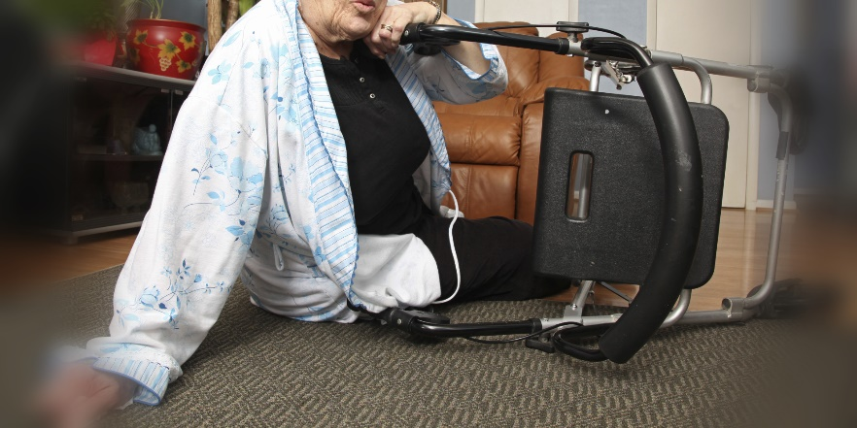

Assisted Living/Nursing Home Stats
More than 2 million adults over the age of 65 living in assisted living/nursing home facilities
50 - 75 % of elder patients suffer ~ 2.6 falls each year. This rate is more than double the rate of falls which occur for elders living in the general community
CDC estimates >5 % of elders, 65 and older, are assisted living residents. But these patients make up > 20 percent of the deaths resulting from falls.
>2,000 elderly patients DIE each year as a result of nursing home falls!
And much of this results from the practice of implementing a low-salt diet policy!

Slide 9
Is there a Standard Practice for Diets in Assisted Living Facilities?
Yes!
One has been in place since 2011, endorsed by the following organizations:
· American Association for Long Term Care Nursing (AALTCN)
· American Association of Nurse Assessment Coordination (AANAC)
· American Dietetic Association (ADA)
· American Medical Directors Association (AMDA)
· American Occupational Therapy Association (AOTA)
· American Society of Consultant Pharmacists
· American Speech-Language-Hearing Association (ASHA)
· Dietary Managers Association (DMA)
· Gerontological Advanced Practice Nurses Association (GAPNA)
· Hartford Institute for Geriatric Nursing (HIGN)
· National Association of Directors of Nursing Administration in Long Term Care (NADONA/LTC)
· National Gerontological Nursing Association (NGNA)

Slide 10
What about Government Endorsement?
The New Dining Standards have been endorsed by the Center for Clinical Standards and Quality/Survey & Certification Group. Department of Health & Human Services, Centers for Medicare & Medicaid Services in 2013.
These Dining Standards for Nursing home/ assisted Living Facilities are now fully in place.
Low-salt diets for those that don’t need them may be Medical Malpractice.

Slide 11


What was the main comment of the Largest Dietary Organization?
American Dietetic Association (ADA) now the Academy of Nutrition and Dietetics - largest organization of food and nutrition professionals, over 100,000 credentialed practitioners
“The relationship between congestive heart failure, blood pressure, and sodium intake in the elderly population has not been well studied. The American Heart Association recommends that older adults attempt to control blood pressure through diet and lifestyle changes and recommends a sodium intake of 2 to 3 g/day for patients with congestive heart failure. However, a randomized trial of adults aged 55 to 83 years found that a normal-sodium diet improved congestive heart failure outcomes. A liberal approach to sodium in diets may be needed to maintain adequate nutritional status, especially in frail older adults.”
This open rejection of establishment dogma is the direct result of a close interaction and long communication and (follow-up) with the Salt Institute.

Slide 12
Where do we go from here?
The Salt Institute is producing a brochure for Nursing Home Managers and Practitioners informing them of the New Dining Practices and their importance.
This will be followed up by a lecture series to Nursing Home/Assisted Living Facility Association meetings to promote the new practices.
The goal is to prevent the elderly from:
“Spending their golden years in a retirement home with a low salt diet that will convert their last years to a long chronic illness”

Slide 13

Thank You

